Slide 1
Microsoft Access
Information management tool that helps you store information for reference, reporting and analysis
Pseudo-relational database allows you to create connections between related data
Part of the Microsoft Office Suite
Data validation
Data entry forms for easy data entry
Simple to complex design

Slide 2
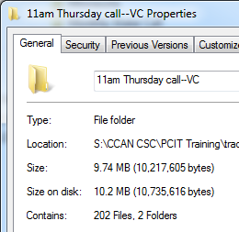
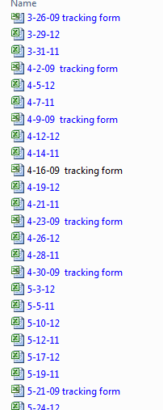
Organized Collection of Data

Slide 3
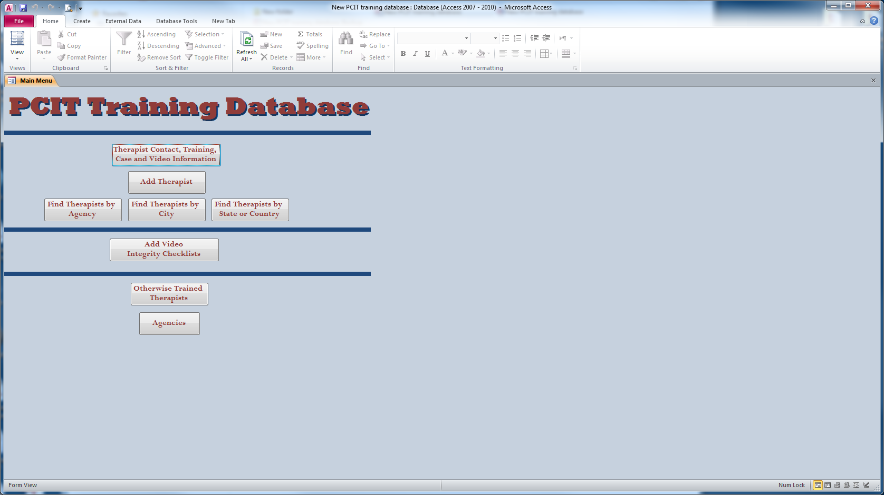
Pcit training database
Used to track everyone we train in PCIT and to keep track of their requirements met for certification. Also used to track consultation participation and their family’s progress.

Slide 4
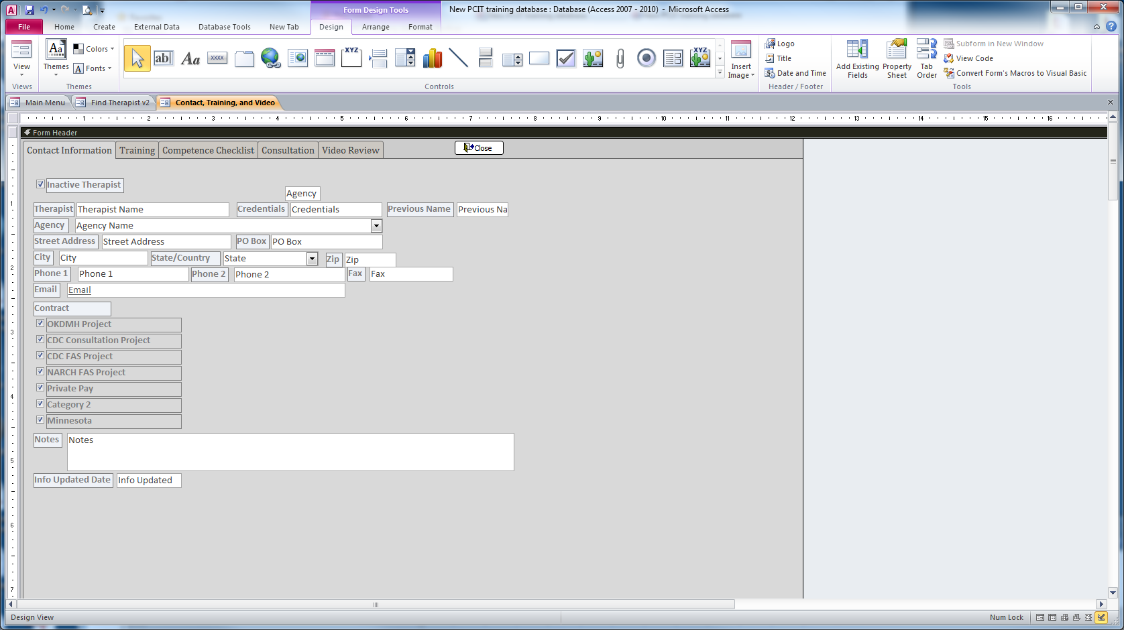
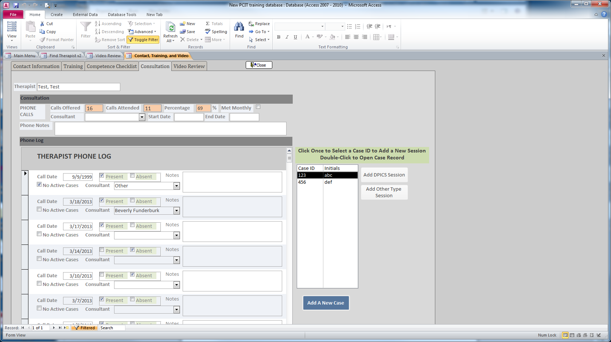
PCIT Training
Therapist contact information
Training completion records
Integrity checklists
Phone log
Case information
Video review

Slide 5
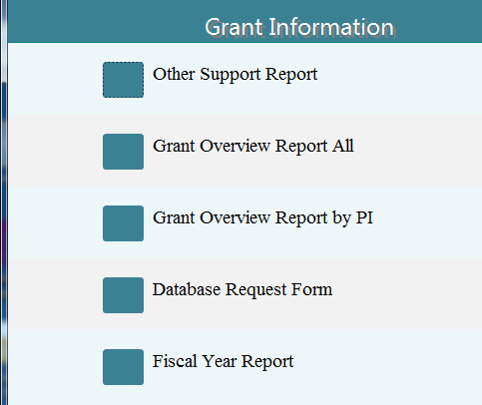
Departmental Grant Database
Section Grants Database
Hands down the database is better than our previous system. A database has parameters for organizing your data. Our previous methods had no structure or consistency. It changed from spreadsheet to spreadsheet, possibly due to different information being requested at different times. They were also spread out over multiple excel spreadsheets. There is no way to know what information overlaps or which spreadsheet contains the correct information. It’s too open ended. The database is a way to combine multiple tables/spreadsheets, provide more structured definitions, and query out any number of sets of data that would have taken someone days before.
~Angela

Slide 6
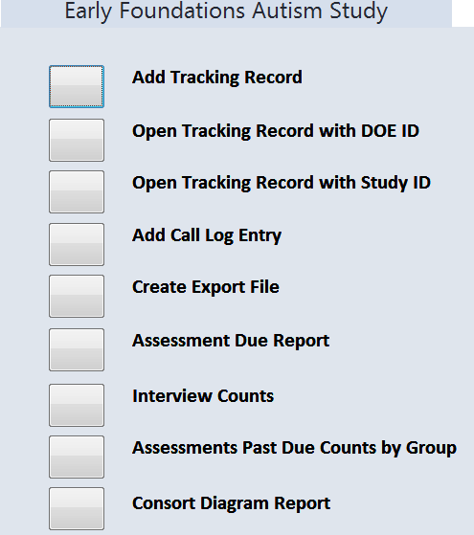
Project DATA Toddler Contacts
Contacts Database
Study Status
Participant
Data Tracking
Study Management
Reporting

Slide 7
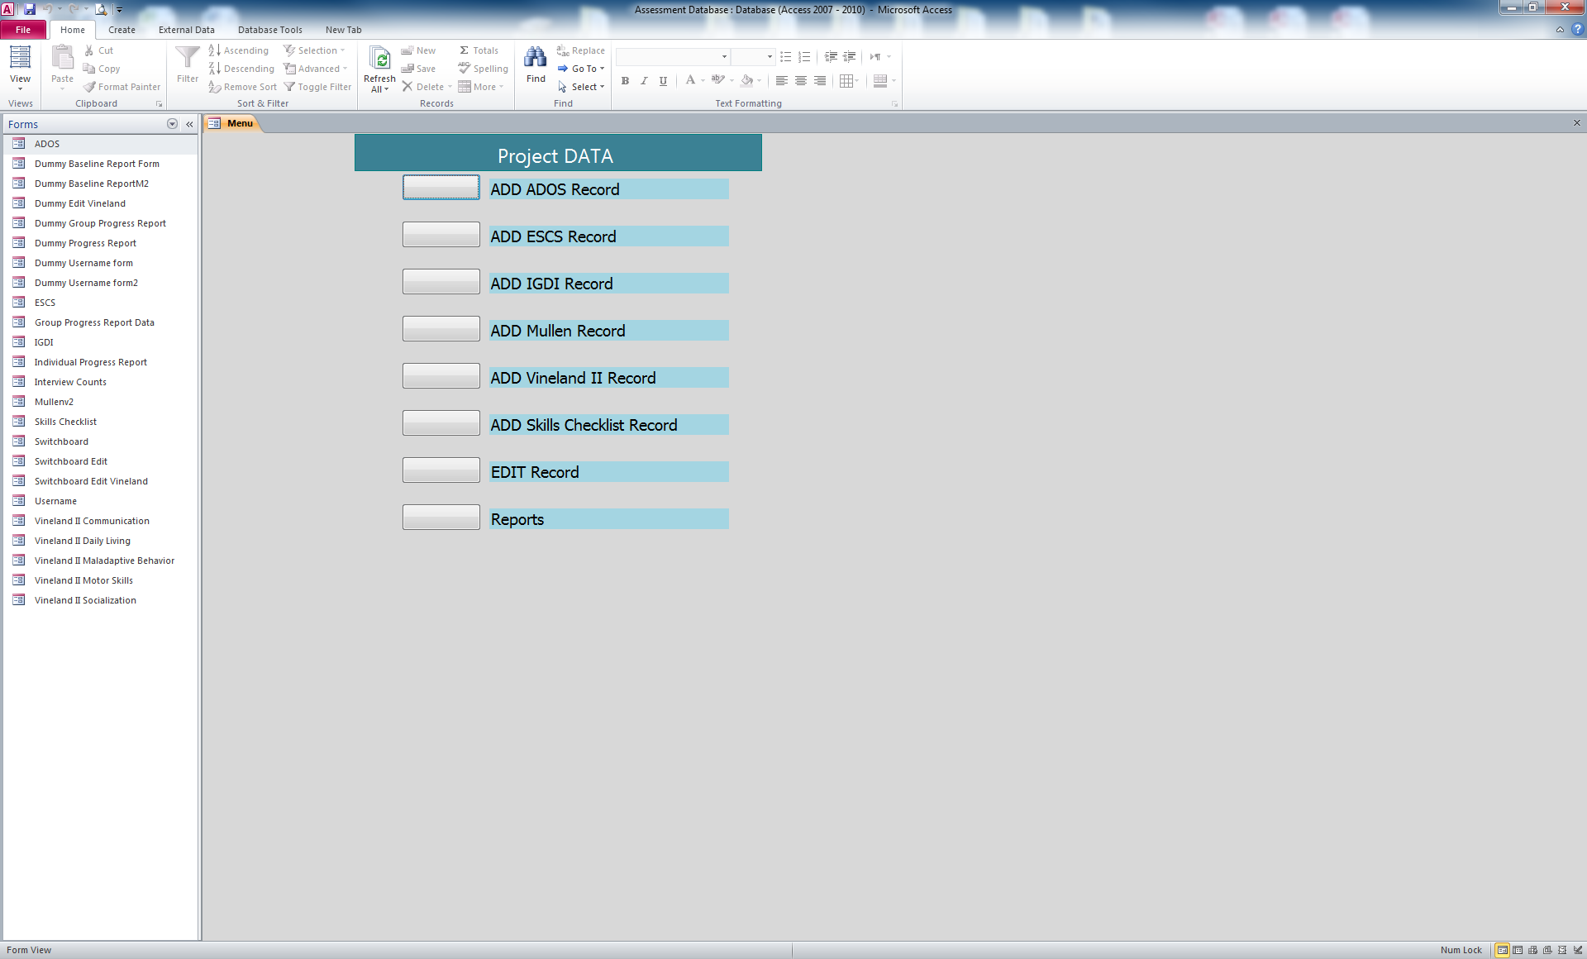
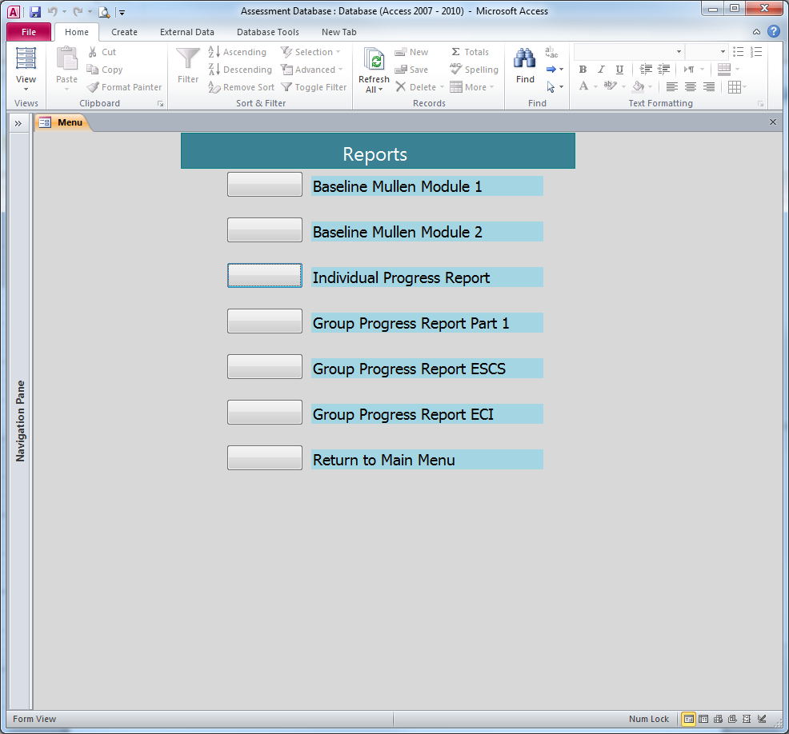
Project DATA Toddler Assessment
Autism Assessment Database
Participant Progress Report
Assessment Outcomes

Slide 8
Sharepoint
Web based, centralized project collaboration application
Document sharing
Calendar and Tasks
Contact Information
Discussions
Announcements
Interface with Microsoft Access and Outlook
Sites

Slide 9
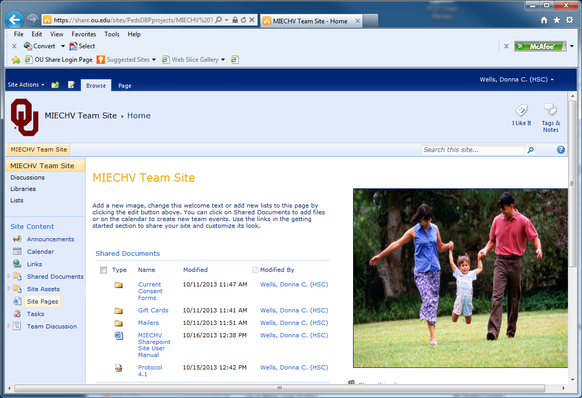
MIECHV team site
SHAREPOINT

Slide 10
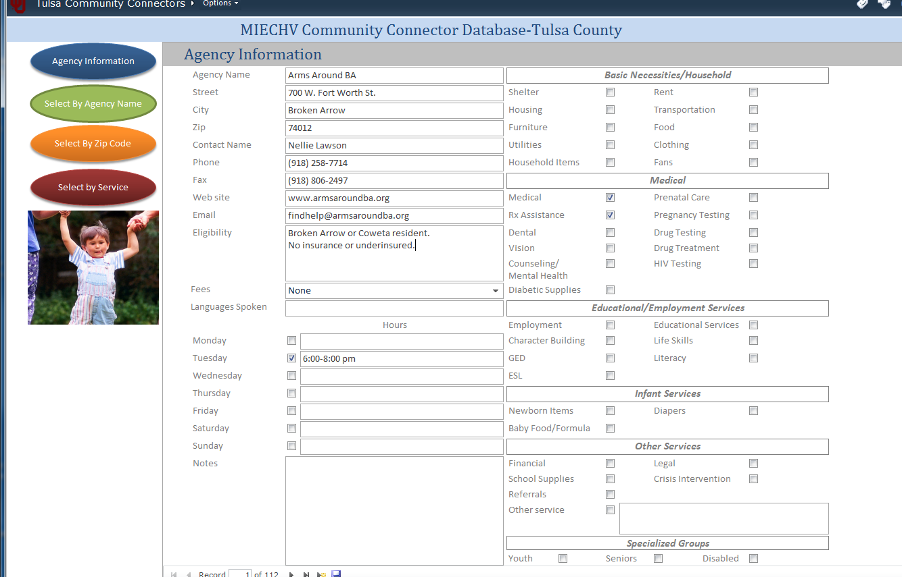
Community Connector site
Sharepoint

